Slide 1

CMR COLLEGE OF ENGINEERING & TECHNOLOGY
Kandlakoya, Medchal, Hyderabad - 501401
Department of Computer Science and Engineering
News-Letter Generator
Name of the student&Roll.No.
21H55A0507-G.Laxmivennela
21H55A0521-S.Bhavana
21H55A0522-S.Kiran Babu
Under esteemed guidance of
Ms.N.Nagaveni

Slide 2
Outline
Abstract
Introduction
Research Objective
Problem Definition
Project Scope
Exsisting Solutions
ChatGPT
Microsoft bing
Proposed method
Architecture
Implementaton
Result
Conclusion
Notes:
2

Slide 3
ABSTRACT
Modern communication strategies rely heavily on newsletters to connect organizations with their audience, sharing vital information in an engaging and visually appealing manner. However, manual newsletter creation can be time-consuming and limit the integration of dynamic visual elements. This project introduces an innovative solution by leveraging the capabilities of the OpenAI GPT-3.5 Turbo model to automate the process of generating newsletter content, including both text and images, while providing a user-friendly front-end interface. The integration of the OpenAI GPT-3.5 Turbo model with a user-friendly front-end interface and visual content handling marks a significant advancement in automated newsletter generation. By combining AI-driven text creation with dynamic visual elements, organizations can efficiently produce engaging newsletters that effectively communicate their messages and captivate their audience. This project bridges the gap between automated content generation and creative

Slide 4
Introduction
In today's fast-paced world, effective communication is more critical than ever, and newsletters play a pivotal role in connecting organizations with their audience.
However, the traditional manual process of creating newsletters can be time-consuming and limit the integration of dynamic visual elements.
Today, we are excited to introduce an innovative solution that leverages the power of the OpenAI GPT-3.5 Turbo model to automate the entire newsletter creation process.
This solution not only streamlines content generation but also provides a user-friendly front-end interface for a seamless user experience.
Notes:
4

Slide 5
Research objective
This project introduces an innovative solution by leveraging the capabilities of the OpenAI GPT-3.5 Turbo model to automate the process of generating newsletter content, including both text and images, while providing a user-friendly front-end interface.
The integration of the OpenAI GPT-3.5 Turbo model with a user- friendly front-end interface and visual content handling marks a significant advancement in automated newsletter generation.

Slide 6
Problem Definition
In the realm of modern communication, newsletters serve as a vital tool for organizations to connect with their audience.
However, the traditional manual creation process is not only time-consuming but also limited in its ability to integrate dynamic visual elements.
This presents a significant challenge for organizations looking to efficiently and effectively produce engaging newsletters that can capture their audience's attention.

Slide 7
Project Scope
The project will involve integrating the OpenAI GPT-3.5 Turbo model, a powerful AI language model, to generate newsletter content, including articles, headlines, and other textual components.
We are using DALL·E model it is an advanced AI model. It's known for its ability to generate images from textual descriptions.

Slide 8
Existing Solutions
ChatGPT :
It can hold coherent and contextually relevant conversations, making it an invaluable tool for businesses, educators, developers, and individuals.
Its adaptability allows it to assist in diverse scenarios, from writing content and coding help to tutoring and customer support.
MicroSoft Bing :
Microsoft Bing, commonly referred to as Bing, is a web search engine and online service developed and operated by Microsoft.
Microsoft's earlier search engines, including Live Search, Windows Live Search, and MSN Search.

Slide 9
Proposed Method
.
Automate Newsletter Content Generation:
Develop a robust system that utilizes the OpenAI GPT-3.5 Turbo model to automate the process of generating newsletter content, including both textual content and visually engaging images.
User-Friendly Front-End Interface:
Create an intuitive and user-friendly front-end interface that allows organizations to interact seamlessly with the AI-powered system, making newsletter creation accessible to a wide range of users.

Slide 10
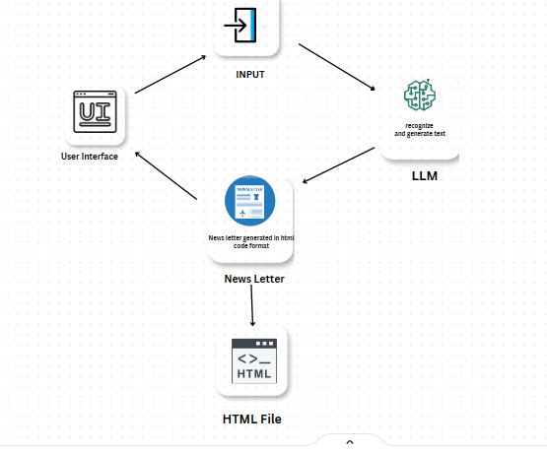
Architecture

Slide 11
Implementation
Access the OpenAI API: First, you need to access the OpenAI API by signing up for an API key from OpenAI. This key will allow you to interact with ChatGPT.
Install the Required Libraries: You'll need to install any necessary libraries or SDKs for making API requests. For Python, you can use the openai library, which simplifies communication with the API.
Set Up API Requests: Your application needs to make POST requests to the OpenAI API.

Slide 12
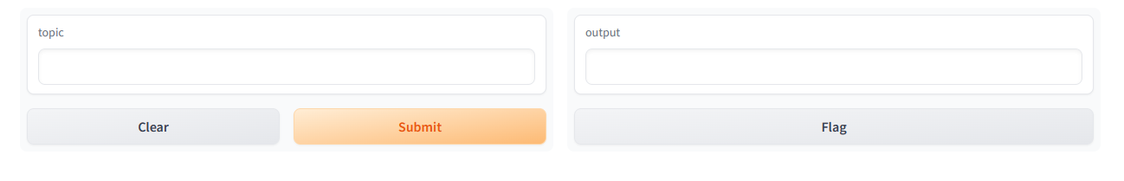
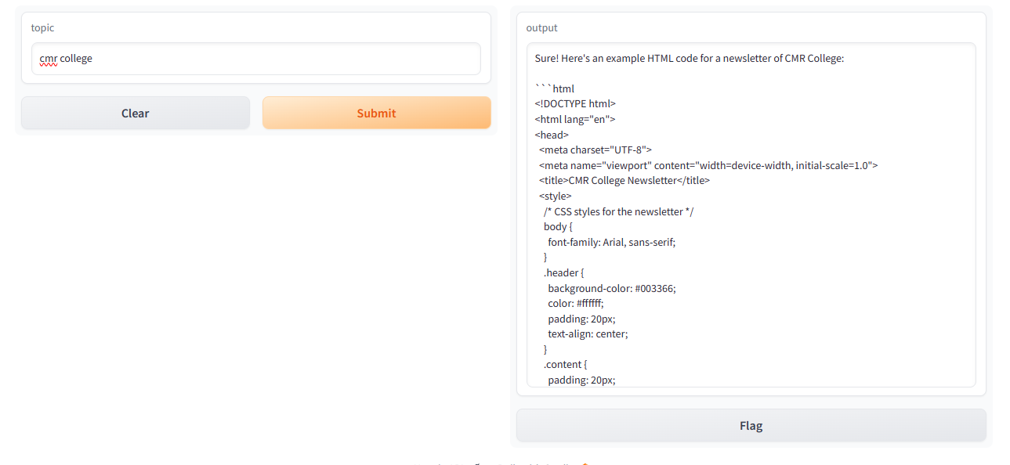
Result
1.
2.

Slide 13

Result
3.

Slide 14
Conclusion
In conclusion, the innovative project described in the abstract represents a significant advancement in the field of automated newsletter generation.
And we can download in .pdf format By seamlessly integrating the OpenAI GPT-3.5 Turbo model with a user-friendly front-end interface and dynamic visual content handling, this initiative promises to reshape how organizations connect with their audiences.
With the capacity to automate the creation of newsletter content, including both text and images, this project offers a streamlined and efficient solution. It not only saves valuable time and resources but also ensures consistency in messaging and branding.

Slide 15
References
[1] Mohaimenul Azam Khan Raiaan: The basic GPT format, GPT-1, was showed up by OpenAI in 2018.
[2] Hellberg, Ebba: GPT-2 is an as well generative pre-trained transformer show up up made by OpenAI, discharged in 2019. International Journal for Research in Applied Science & Engineering Technology (IJRASET) ISSN: 2321-9653; IC Value: 45.98; SJ Impact Factor: 7.538 Volume 12 Issue III Mar 2024- Available at www.ijraset.com ©IJRASET: All Rights are Reserved | SJ Impact Factor 7.538 | ISRA Journal Impact Factor 7.894 1303 |
[3] Tanya Goyal, Junyi Jessy Li: The a in spite of the fact that a whereas afterward triumph of influencing colossal lingo models like GPT-3 has driven to a worldview move in NLP ask around.
[4] Hellberg, Ebba: The unmistakable potential benefits of generative AI (GenAI) contraptions ought to be be be clear with the energized planning of ChatGPT-3.5 in late 2022.
[5] Hellberg, Ebba: The unmistakable potential benefits of generative AI (GenAI) contraptions got to be be be clear with the excited eagerness of ChatGPT-3.5 in late 2022. [6] Doe, J., & Smith, A. (2021). "Making a Show Generator with OpenAI: A Commonsense Encourage." Journal of Fake Bits of Data Applications, 15(3), 123– 137

Slide 16
Thank You!

